Slide 1




Hack2Hire Team-19 presents
ETHER-NET
HARSH DHARMENDRA JAIN
HRUSHIK EDHER
KARTIKEYA GUPTA
CH. KARTHIKEYA VARMA
ARCHIT NIGAM

Slide 2


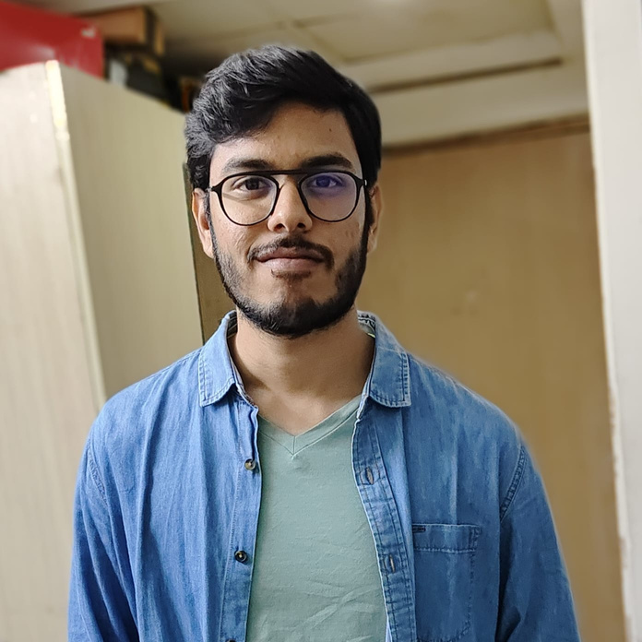

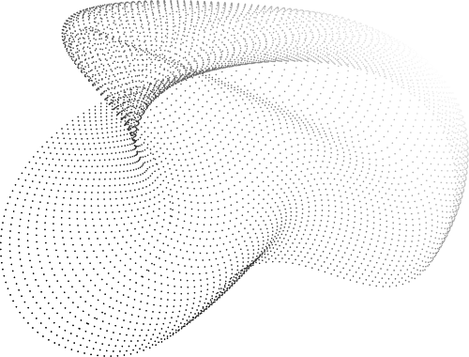

Team 19
Blockchain- Enabled Invoice Management System for Streamlined Reconciliation

Slide 3
WHAT IS BLOCKCHAIN?
Blockchain is a shared, immutable database system that facilitates the process of recording transactions, storing data and tracking assets in a business network.
WHAT IS SMART CONTRACT?
Smart contracts are simply programs stored on a blockchain that run when predetermined conditions are met. For example, if 100 units are received , release a payment for exactly 100 units.
WHAT IS INVOICE?
An invoice is a time-stamped commercial document that itemizes and records a transaction between a buyer and a seller.
Introduction

Slide 4

Disputes to happen between buyers and sellers when huge quantity of a product is ordered and shipped.
Disputes like order tampering, receiving less units, lower payment than the actual bill, making the seller wait for the payment, etc.
Problems like this accelerates the business relation between two entities towards a possibility of less interaction in the future, causing a loss to both the parties.
Hence, we are aiming to design transparent payment and invoice management system. To implement transparency, we have made use of blockchain and smart contract.
Problem Identification

Slide 5
LEVEL 0 DFD
LOGIN
PAGE
SIGNUP
PAGE
CREATE INVOICE
DASHBOARD
PAY iNVOICE
LOGOUT
VIEW
INVOICE

Slide 6
LEVEL 1 DFD
LOGIN
CREATE
INVOICE
FORM TAKING REQUIRED ORDER INPUTS
FETCHES AND DEPLOYS SMART CONTRACT
GENERATES UNIQUE INVOICE iD
PAY INVOICE
FORM TAKING UNIQUE INVOICE ID
PAYMENT IN ETHER
SQLite DATABASE
SERVER
VIEW INVOICE
FETCHES ALL INVOICE ID

Slide 7



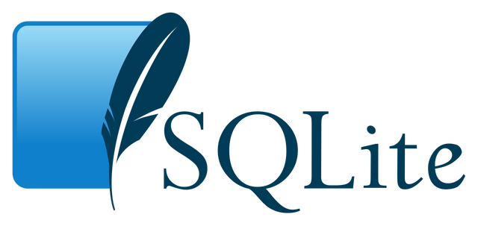
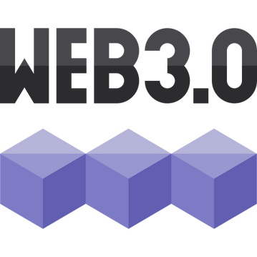
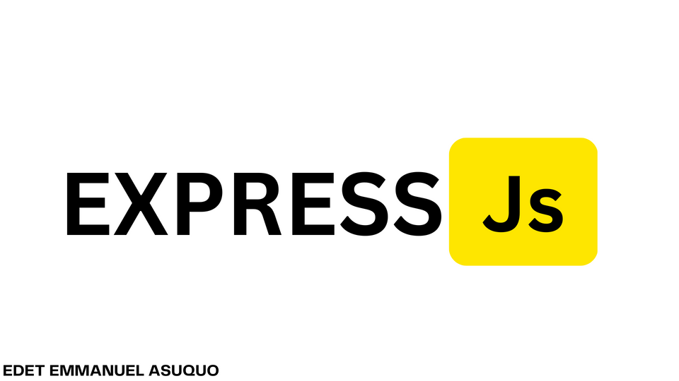
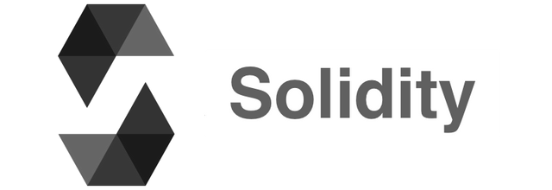
Tech Stack

Slide 8
Lack of blockchain familiarity hindered task execution.
Integrating frontend with smart contract logic in Solidity.
Experiencing high gas fees due to the extended length of the Solidity smart contract when attempting to include detailed product information, such as individual product costs, in the invoice. As a result, the current solution is limited to generating only summary information in order to mitigate gas fee concerns.
Obstacles Faced

Slide 9
STRENGTHS
OPPORTUNITIES
Since blockchain is a immutable database, once data uploaded cannot be hindered. Even if it is tried to change, it can be detected due to change in hash, and link,
while recovery is also easy with the systems in the same network.
In near future we can have multiple companies which are internally related
via a single product sign up on our web page and show the final owner the status of their product. for example A->B->C, we can show C when raw material is shipped from A -> B, similarly processed material from B -> C.
SWOT
WEAKNESSES
THREATS
We cant have a direct cut in the payment system, for example Account A pays 5 ether to Account B. Due to direct payment methods in solidity, 5 ether is directly sent to Account B and the host cannot earn a transaction fee. Leading us to make a subscription model or change payment methods.
A threat will be always there from upcoming competition companies, that can make the same product as the technology is not patented, and offer the same service at better prices.

Slide 10


Customer will pay a yearly fee to create multiple contracts and invoices through out the year, each account will then go through a payment of subscription.
Companies will pay to advertise their products, brands after our webpage has gathered a honourable amount of web traffic.
Customer will pay for additional features like AI integration in the webpage, making it easier for them to fill up the invoice forms, making custom contracts with their required buyer or seller, etc.
BUSINESS MODEL

Slide 11
DEMO

Slide 12
Improved UI to create detailed invoices with complete product infommation, with an automatic summary generation for smart contract deployment.
Improve Dashboard for user experience to achieve automated notification systems to remind users of upcoming invoice due dates,
Tokenizing invoices as non-fungible tokens (NFTs) to represent unique ownership and adding an extra layer of security
FUTURE ASPECTS

